Slide 1
Intro to Python Week 2 - variables

Slide 2
Overview
Python Variables
Declare a variable
Operators
Numbers

Slide 3
What is a variable
Variables are nothing but reserved memory locations to store values. This means when you create a variable, you reserve some space in memory.
Based on the data type of a variable, the interpreter allocates memory and decides what can be stored in the reserved memory. Therefore, by assigning different data types to variables, you can store integers, decimals, or characters in these variables.

Slide 4
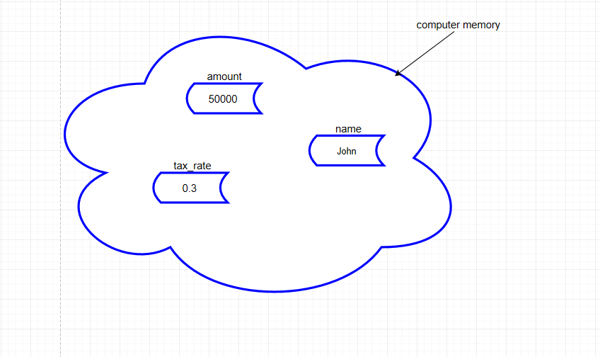
Graphic of a Variable

Slide 5
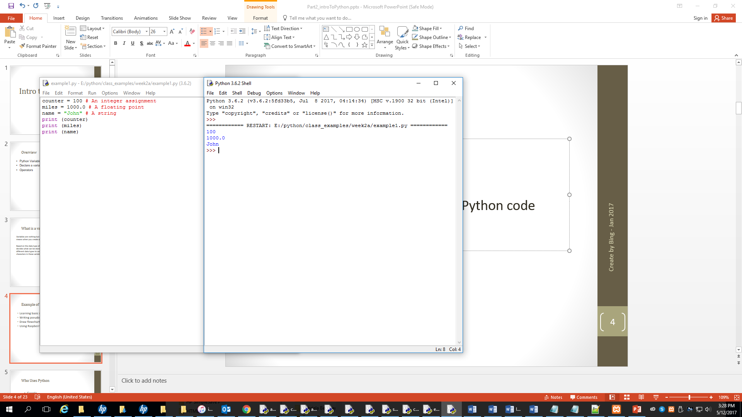
Example of Variables
Note: You print the value of the memory from a variable without the quotation marks. You print out the name of a variable without quotation marks.

Slide 6
Multiple assign the values
a=b=c = 100
The code above to assign value 100 to memory a, b and c
x, y, z = 100, 200, “Bing”
The code above to assign 100 to x, 200 to y name “Bing” to z

Slide 7
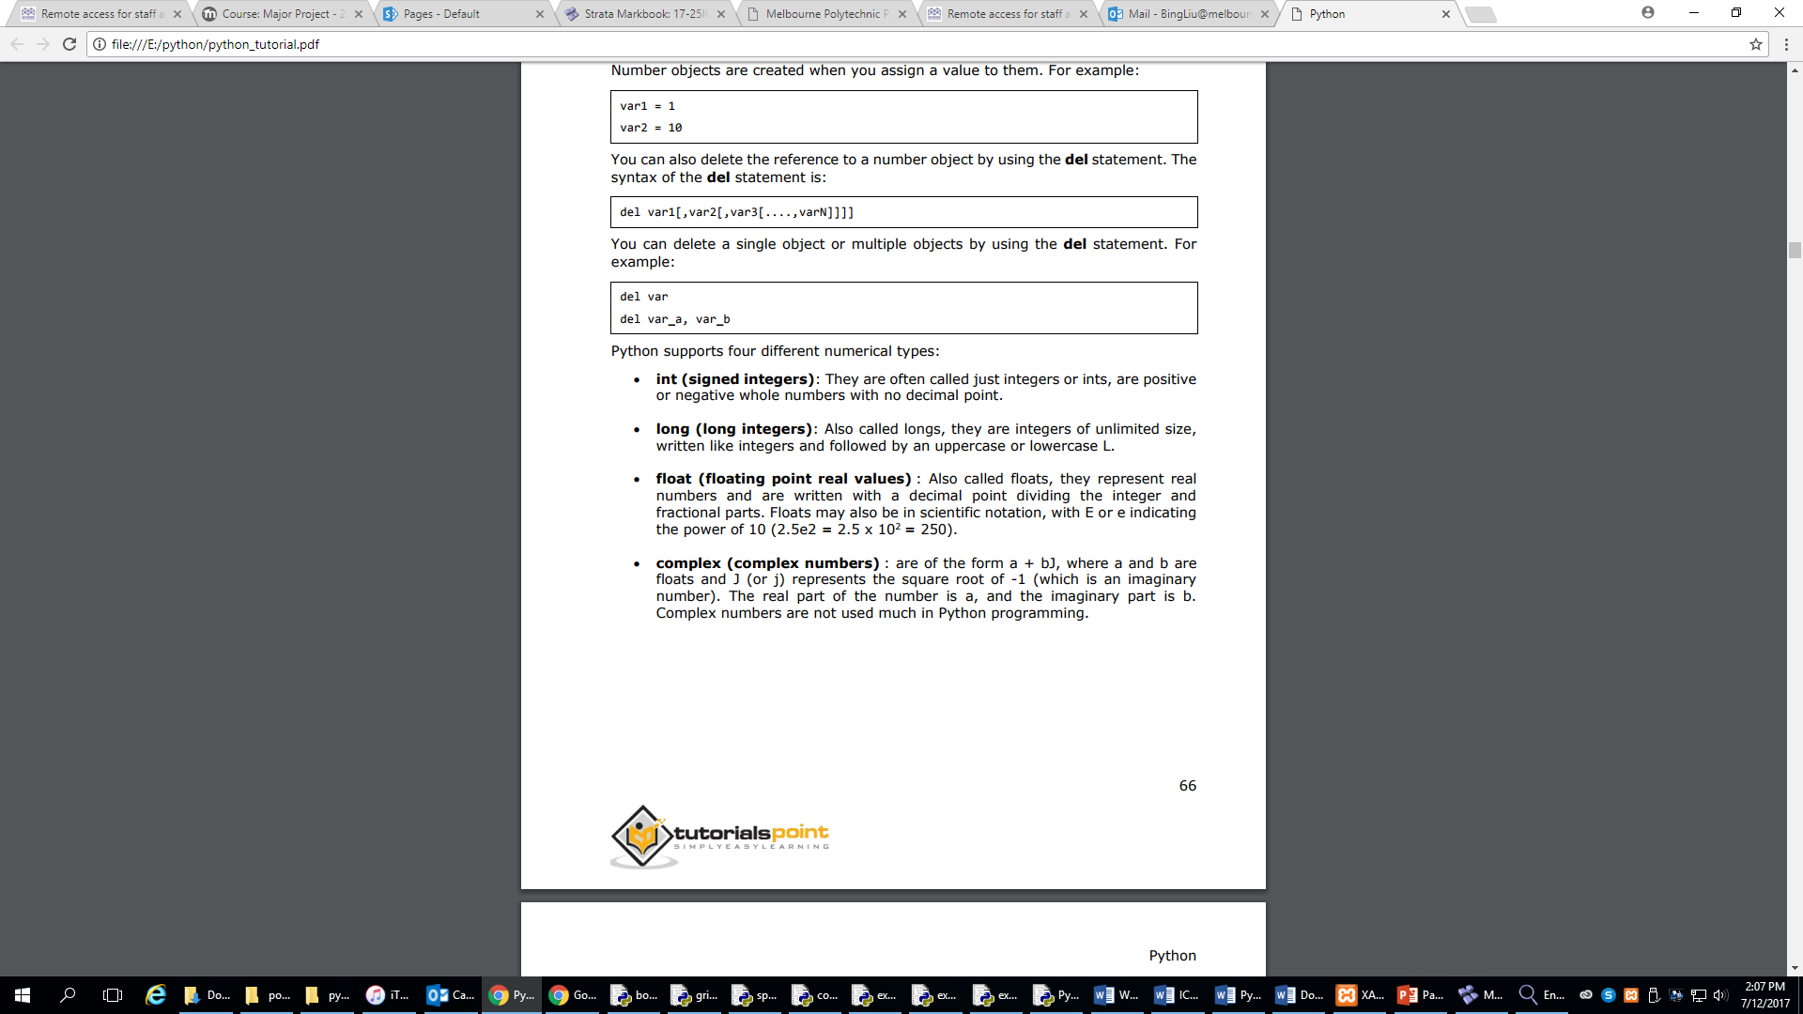
Numbers

Slide 8
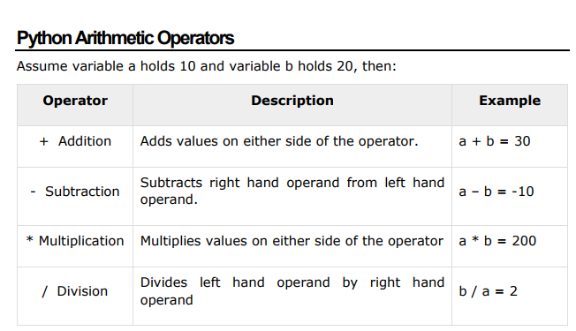
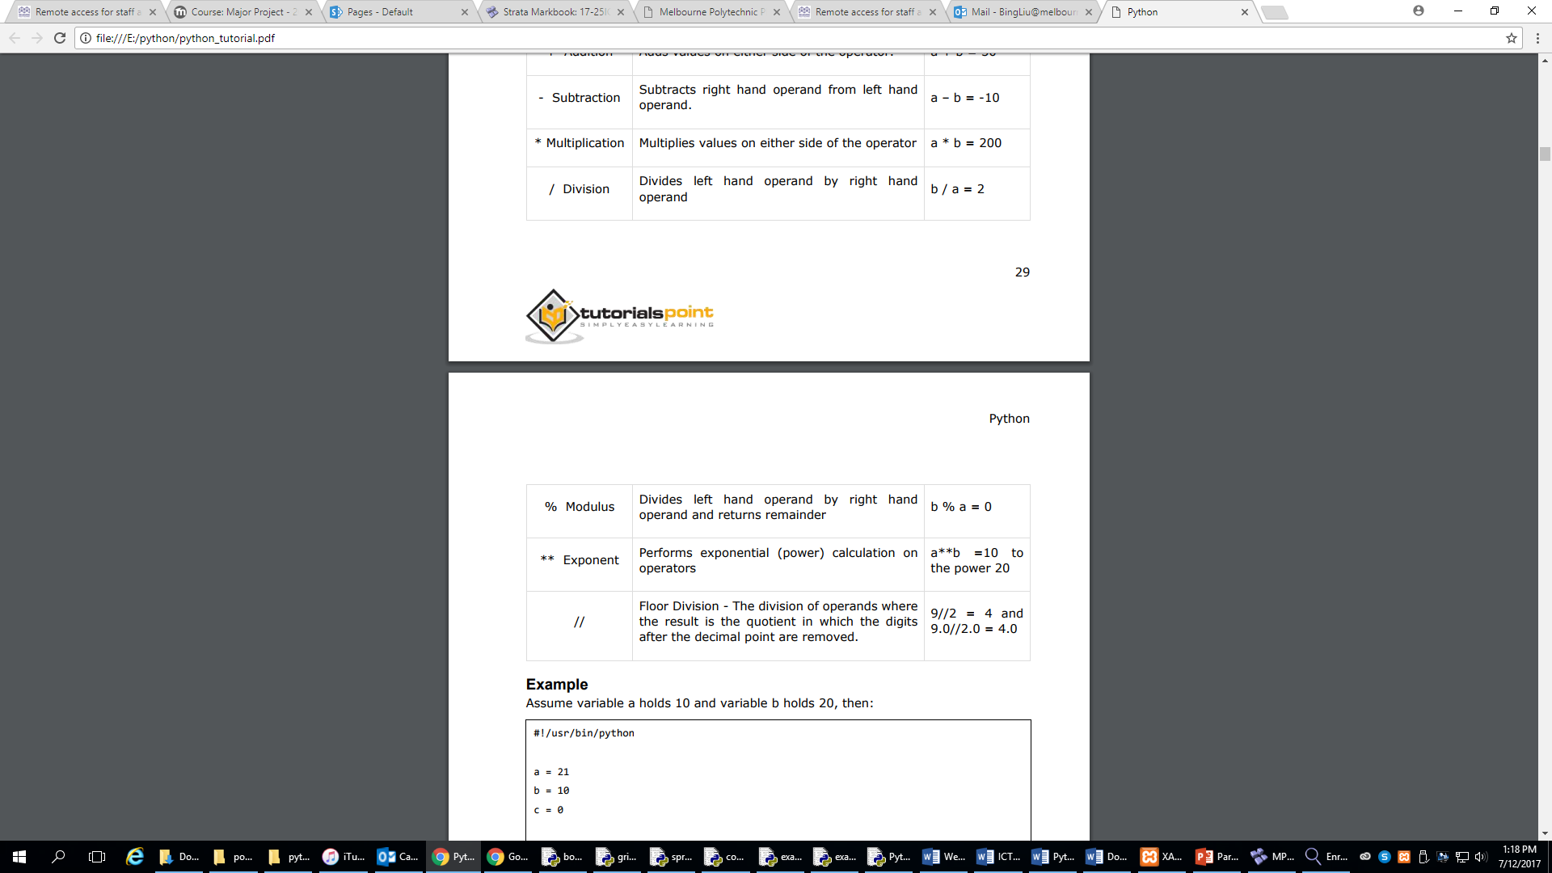
Operators

Slide 9
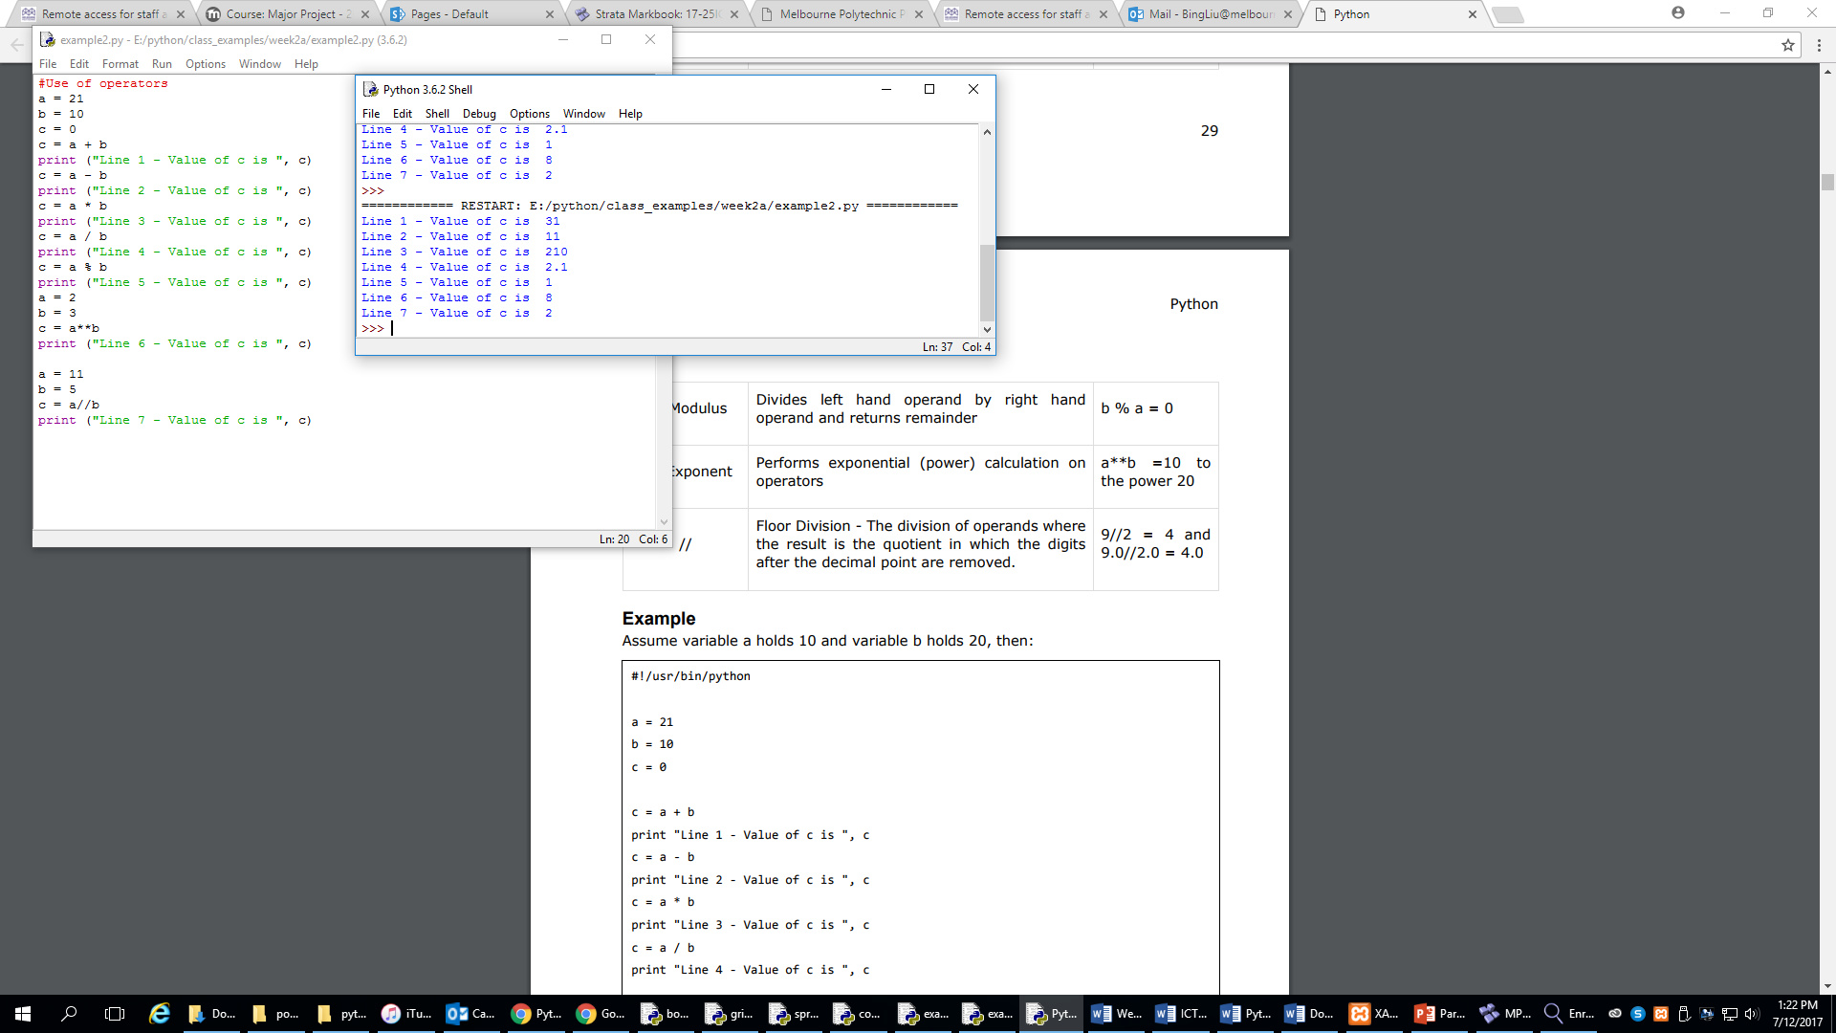
Example of operators

Slide 10
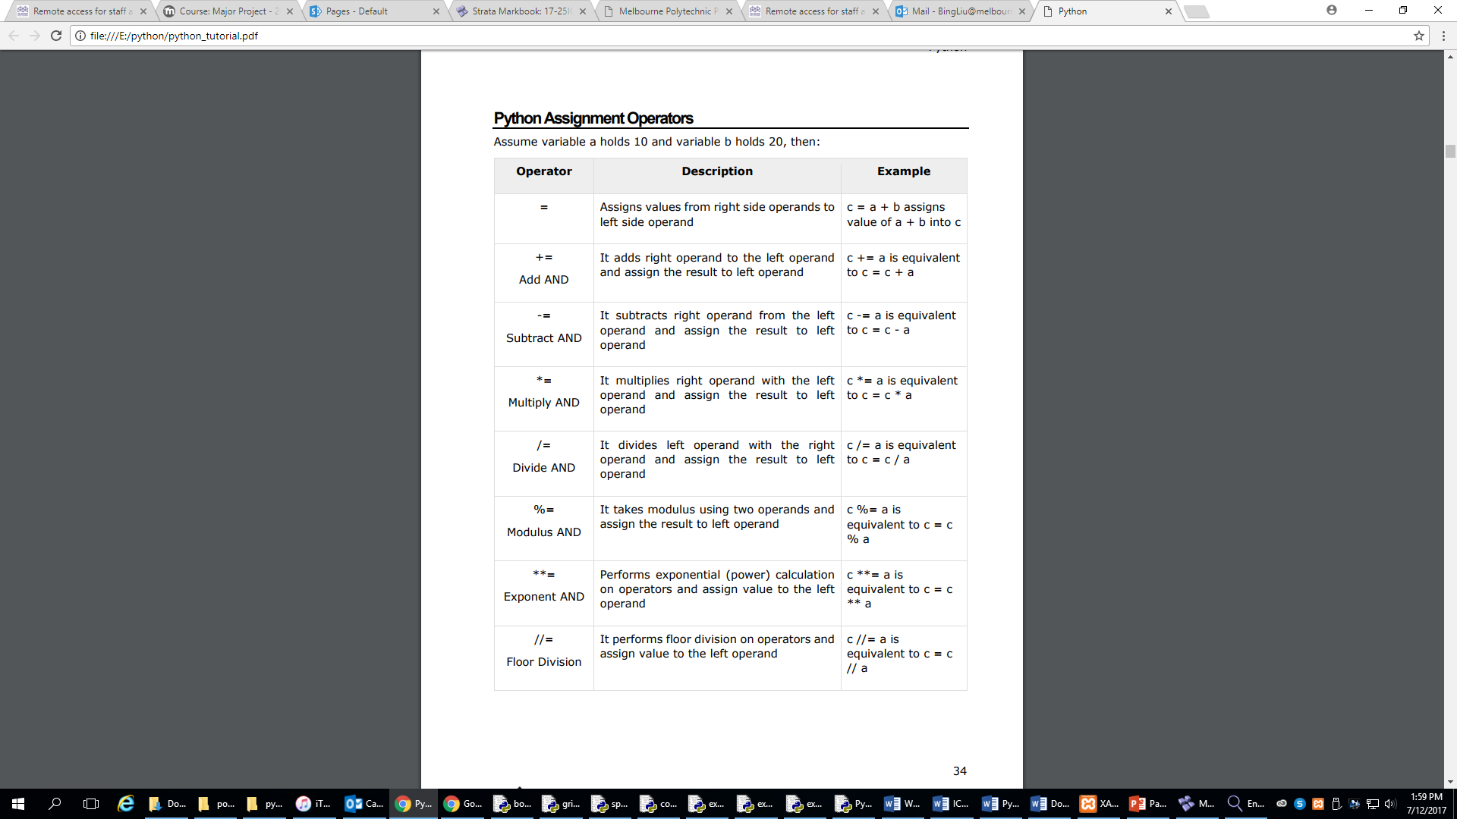
Assignment Operators

Slide 11
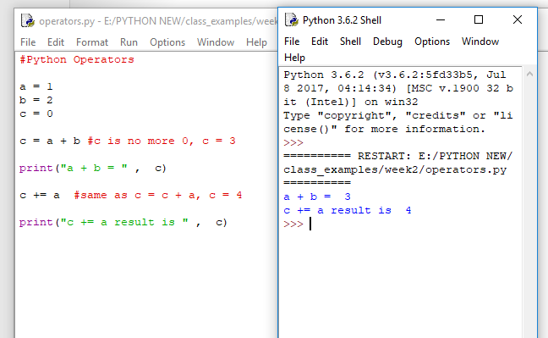
Example 1

Slide 12
Example 1– Flowchart and Pseudocode
START
START Terminal
SET value to variables a and b
Assign value to a, b
PROCESS: calculate c
Calculate c
Display c
DISPLAY c
END
End Terminal

Slide 13
Convert String to number
Functions | Return(descriptions) | Examples
int() | Convert to an integer number | number = “5” number = Int(number) number is a numeric number 5
float() | Convert to a decimal number | number = “5.8” number = float(number) number is a numeric number 5.8

Slide 14
Convert int to string
The syntax of using the str() method will a value into string
Example 1 :
str_x = "A string to int conversion demo:"
a = 123
print (str_x, str(a))

Slide 15

Using int variable in concatenation example
str_x = "A string to int conversion demo:"
a = 123
print (str_x + a)

Slide 16
Number Functions
Functions | Return(descriptions)
math.floor(x) | The floor of x: result is the integer number <= x
math.ceil(x) | The ceil of x: result is the integer number >= x
random.randint(a, b) | The program generate a random number between a and b
Note: You must import math and random into your program

Slide 17
Reference
www.tutorialspoint.com
http://twitter.com/tutorialspoint
If number >0
Display message

